Slide 1
Manifold-Aware Macroeconomic Stress Path Construction
Adam Fowlie - University of Edinburgh
Dr. Usama Nadeem - TNP
Dr. Etienne Hofstetter - TNP

Slide 2
Stress testing
Want to model paths between two economic scenarios
Why do we want to do this?
The endpoint matters, but the path between them may matter
Figure: Normal state --?--> Stressed state

Slide 3
Introduce current path generation methods
PCA, … linear methods

Slide 4
Manifold hypothesis
In many models we assume that there is an underlying latent process driving macroeconomic observables.
This gives rise to the manifold hypothesis, where variables may live in high-dimensional space, but be restricted to a lower dimensional manifold.

Slide 5
Goal
Can we construct paths between two economic endpoints that remain close to this manifold?

Slide 6
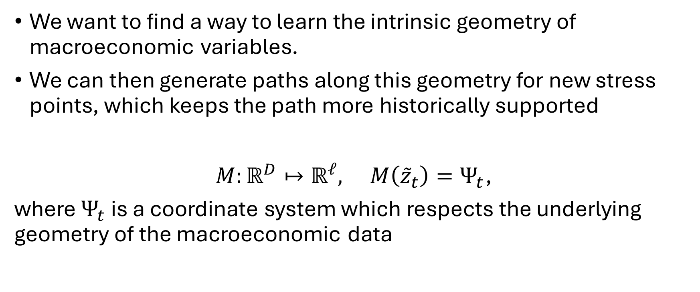
How we intend to achieve our goal
We want to find a way to learn the intrinsic geometry of macroeconomic variables.
We can then generate paths along this geometry for new stress points, which keeps the path more historically supported
$M:ℝ^{D}↦ℝ^{ℓ}, M\left({\overset{˜}{z}}_{t}\right)=Ψ_{t}$,
where $Ψ_{t}$ is a coordinate system which respects the underlying geometry of the macroeconomic data

Slide 7
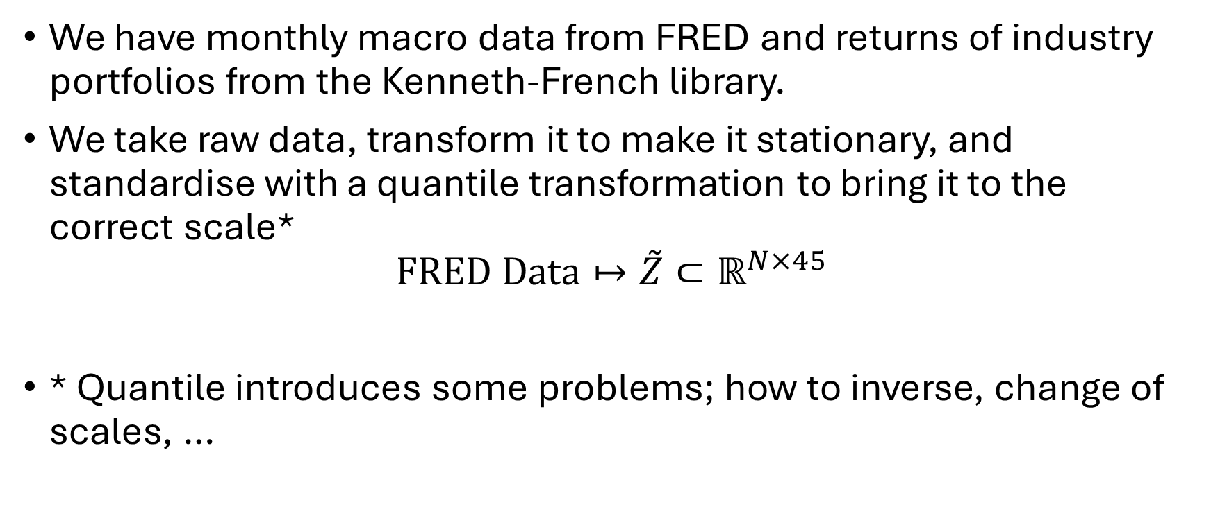
Data
We have monthly macro data from FRED and returns of industry portfolios from the Kenneth-French library.
We take raw data, transform it to make it stationary, and standardise with a quantile transformation to bring it to the correct scale*
$$\text{FRED} \text{Data}↦\overset{˜}{Z}⊂ℝ^{N×45}$$
* Quantile introduces some problems; how to inverse, change of scales, …

Slide 8
Diffusion maps

Slide 9
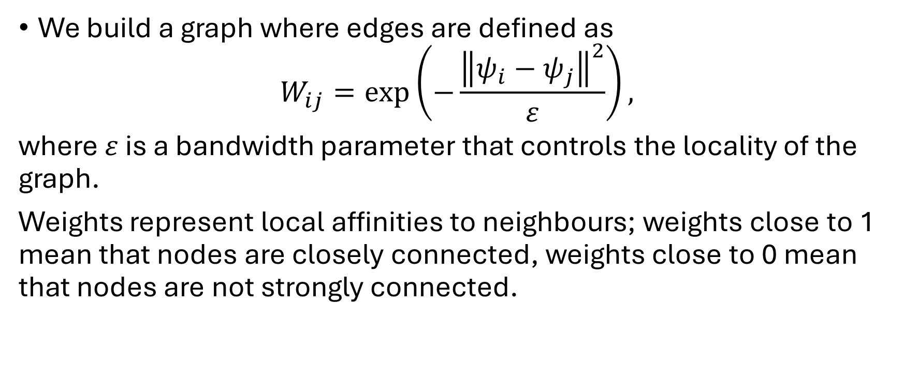
Building a graph
We build a graph where edges are defined as
$$W_{ij}=\exp\left(−\frac{{\left\|ψ_{i}−ψ_{j}\right\|}^{2}}{ε}\right),$$
where $ε$ is a bandwidth parameter that controls the locality of the graph.
Weights represent local affinities to neighbours; weights close to 1 mean that nodes are closely connected, weights close to 0 mean that nodes are not strongly connected.

Slide 10
Normalised transition matrix
The weight matrix is normalised to remove the effect of sampling density
The resulting matrix is normalised to form a transition matrix, where each element represents the probability of a random walk stepping from node i to node j.

Slide 11
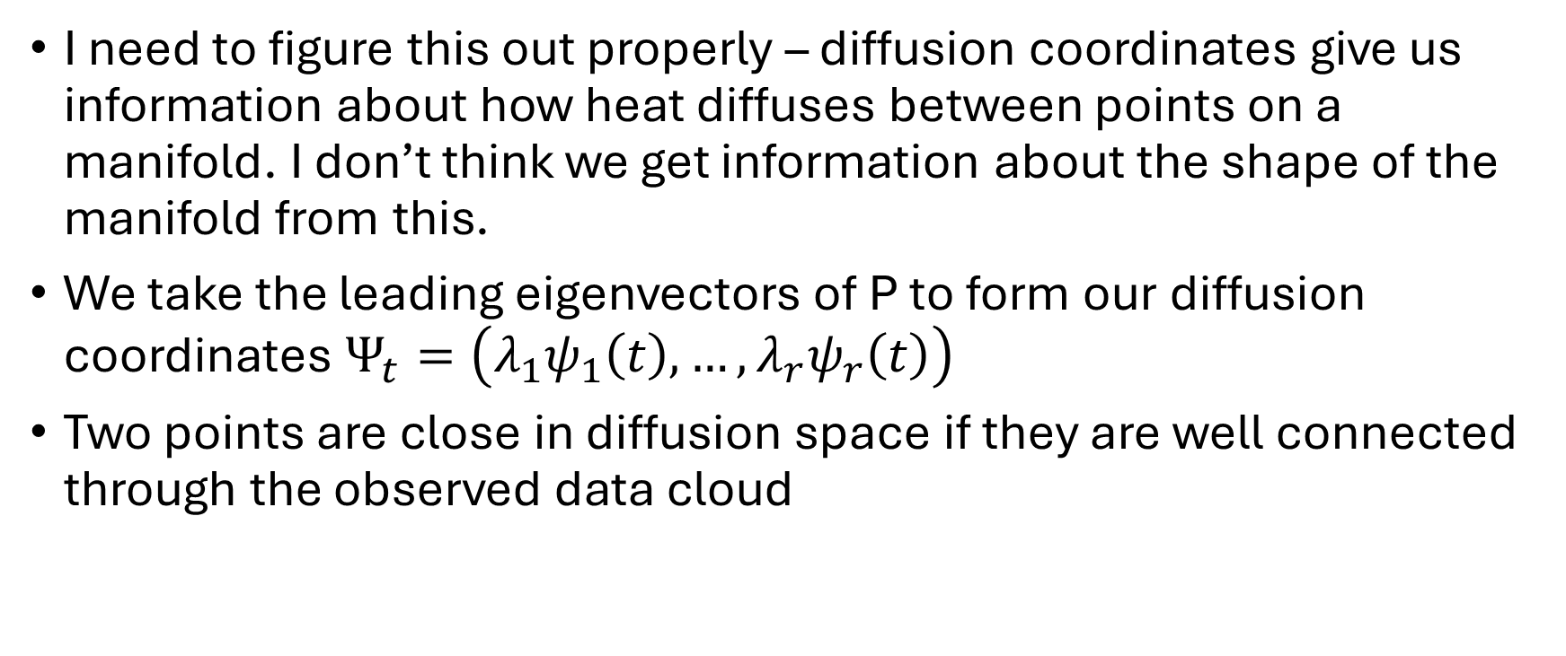
What diffusion coordinates represent
I need to figure this out properly – diffusion coordinates give us information about how heat diffuses between points on a manifold. I don’t think we get information about the shape of the manifold from this.
We take the leading eigenvectors of P to form our diffusion coordinates $Ψ_{t}=\left(λ_{1}ψ_{1}\left(t\right),…,λ_{r}ψ_{r}\left(t\right)\right)$
Two points are close in diffusion space if they are well connected through the observed data cloud

Slide 12
Our diffusion embedding
Show the diffusion coordinates coloured by different variables
Maybe animations or maybe just images

Slide 13
Density and plausibility

Slide 14
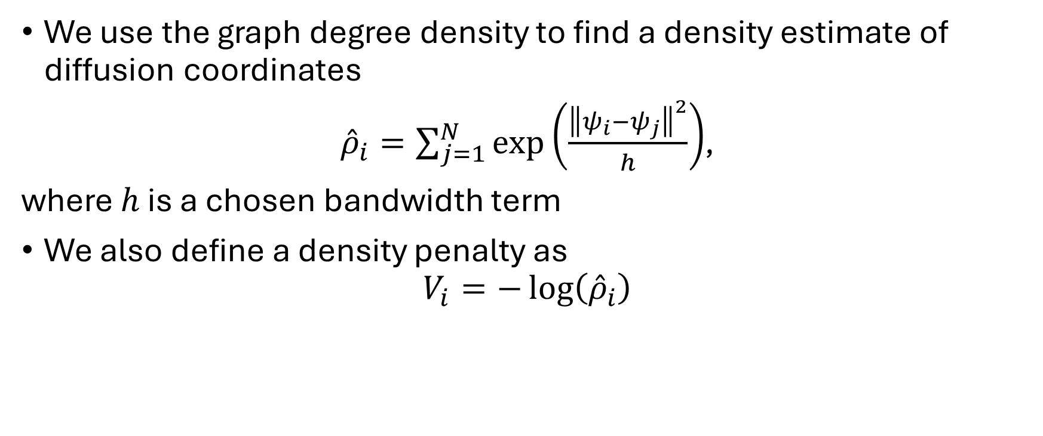
Density in diffusion space
We use the graph degree density to find a density estimate of diffusion coordinates
${\overset{ˆ}{ρ}}_{i}=\sum_{j=1}^{N}{\exp\left(\frac{{\left\|ψ_{i}−ψ_{j}\right\|}^{2}}{h}\right)}$,
where $h$ is a chosen bandwidth term
We also define a density penalty as
$$V_{i}=−\log\left({\overset{ˆ}{ρ}}_{i}\right)$$

Slide 15
Is there a link between density and plausibility
In this project, we imply a link between diffusion coordinate density and macroeconomic plausibility. We intent to provide evidence for this
Figure: plot of density penalty vs time with NBER points highlighted
Figure: plot of high penalty points not in NBER and explanation of a few
* Investigate whether we can explain why any month is an outlier, even if not low-density

Slide 16
Density and closeness in macro space
Figure: density vs distance macro space
Found a -0.48 correlation (Spearman – 0.47 distance correlation), so higher-density points correspond to macroeconomic points which are closer to other points.
This implies that density correlates with historical support; it doesn’t necessarily say that it correlates with plausibility or probability.

Slide 17
Density-aware stress paths

Slide 18
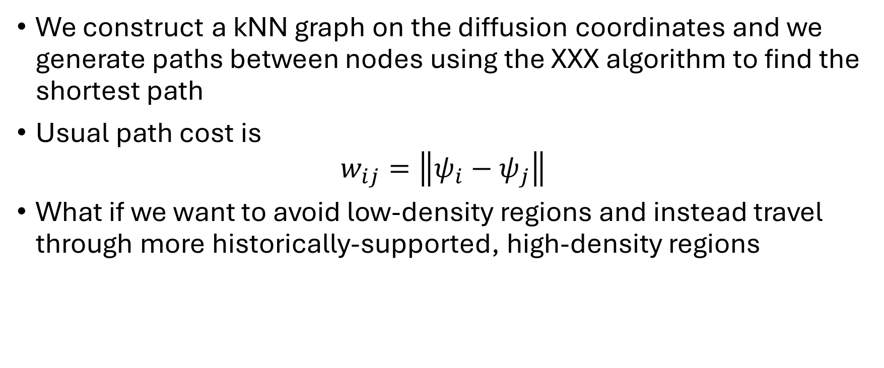
Usual shortest path
We construct a kNN graph on the diffusion coordinates and we generate paths between nodes using the XXX algorithm to find the shortest path
Usual path cost is
$$w_{ij}=\left\|ψ_{i}−ψ_{j}\right\|$$
What if we want to avoid low-density regions and instead travel through more historically-supported, high-density regions

Slide 19
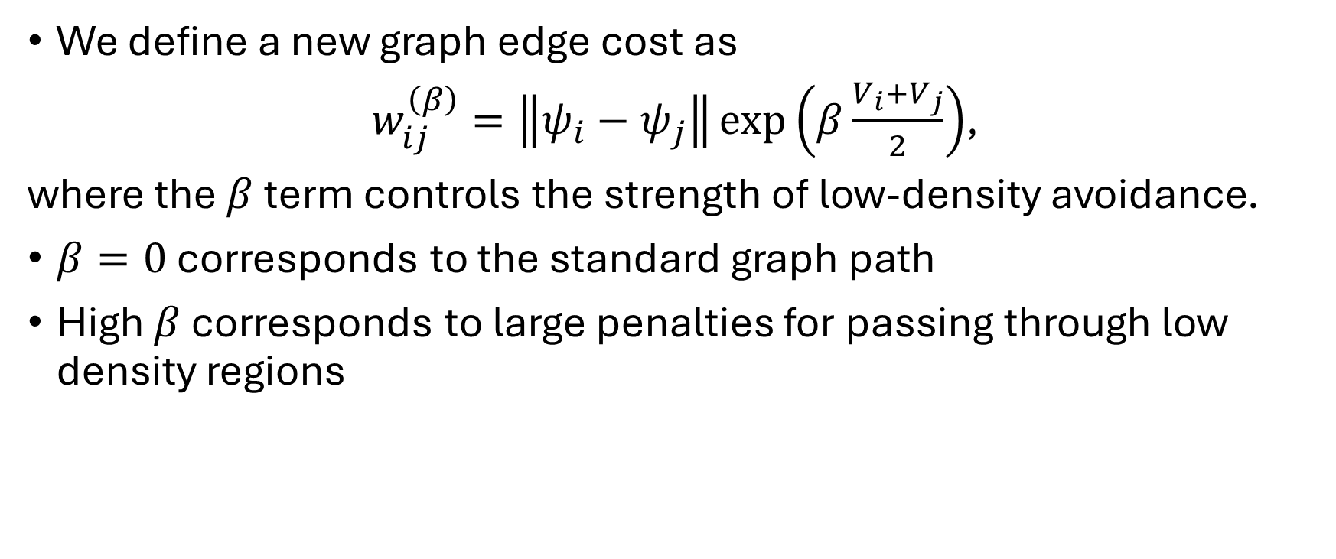
Density-aware graph cost
We define a new graph edge cost as
$w_{ij}^{\left(β\right)}=\left\|ψ_{i}−ψ_{j}\right\|\exp\left(β\frac{V_{i}+V_{j}}{2}\right)$,
where the $β$ term controls the strength of low-density avoidance.
$β=0$ corresponds to the standard graph path
High $β$ corresponds to large penalties for passing through low density regions

Slide 20
Density results
Increasing beta reduces the minimum density along graph paths
Using density-aware graph paths always improves minimum density versus linear paths through diffusion space. (Justify use of linear path through diffusion space)
There is a trade-off between path length and minimum density – possibly not even a trade-off, but perhaps something to note because it’s very intuitive

Slide 21
Path visualisation
Plots of different paths through diffusion coordinates
Animations or images…

Slide 22
Lifted paths
Explain that we lift the linear paths to macro space by finding a weighted combination of each point on the path’s nearest neighbours.
Graph paths can be lifted by looking at the index – we’ve not explored lifting unobserved graph paths.
Compare paths to PCA paths

Slide 23
Lifted paths plots
Show plots of different macroeconomic variables along paths.
Show how linear paths (including PCA) cut through space, while graph paths fluctuate to stay on the manifold

Slide 24
HMM supporting validation
HMM assumes that the process is driven by unobserved states with Gaussian distributions. Each point in time is assumed to come from one of K distributions; the model estimates these distributions given our embedding coordinates Psi
We can then ask the question: “given different paths between endpoints, how likely is it that they follow this model”
We find that graph paths are more likely than linear paths. This makes sense because the graph paths are made up of diffusion points, which the model has been fitted on. What is the justification for using this if pressed?

Slide 25
Conclusions

Slide 26
Contributions
Learned nonlinear macroeconomic geometry
Constructed density-aware graph stress paths
Showed paths can avoid historically unsupported regions
Connected path construction to interpretable macro scenarios.

Slide 27
Limitations
Density is historical support, not future probability
Can only generate paths through historical observations
HMM validation remains preliminary.

Slide 28
Possible extensions
Connect paths to portfolio losses or balance-sheet variables
Generate Monte Carlo paths on the learned manifold
Now everything is discrete; finding a way to generate smooth manifolds would be nice

